Slide 1

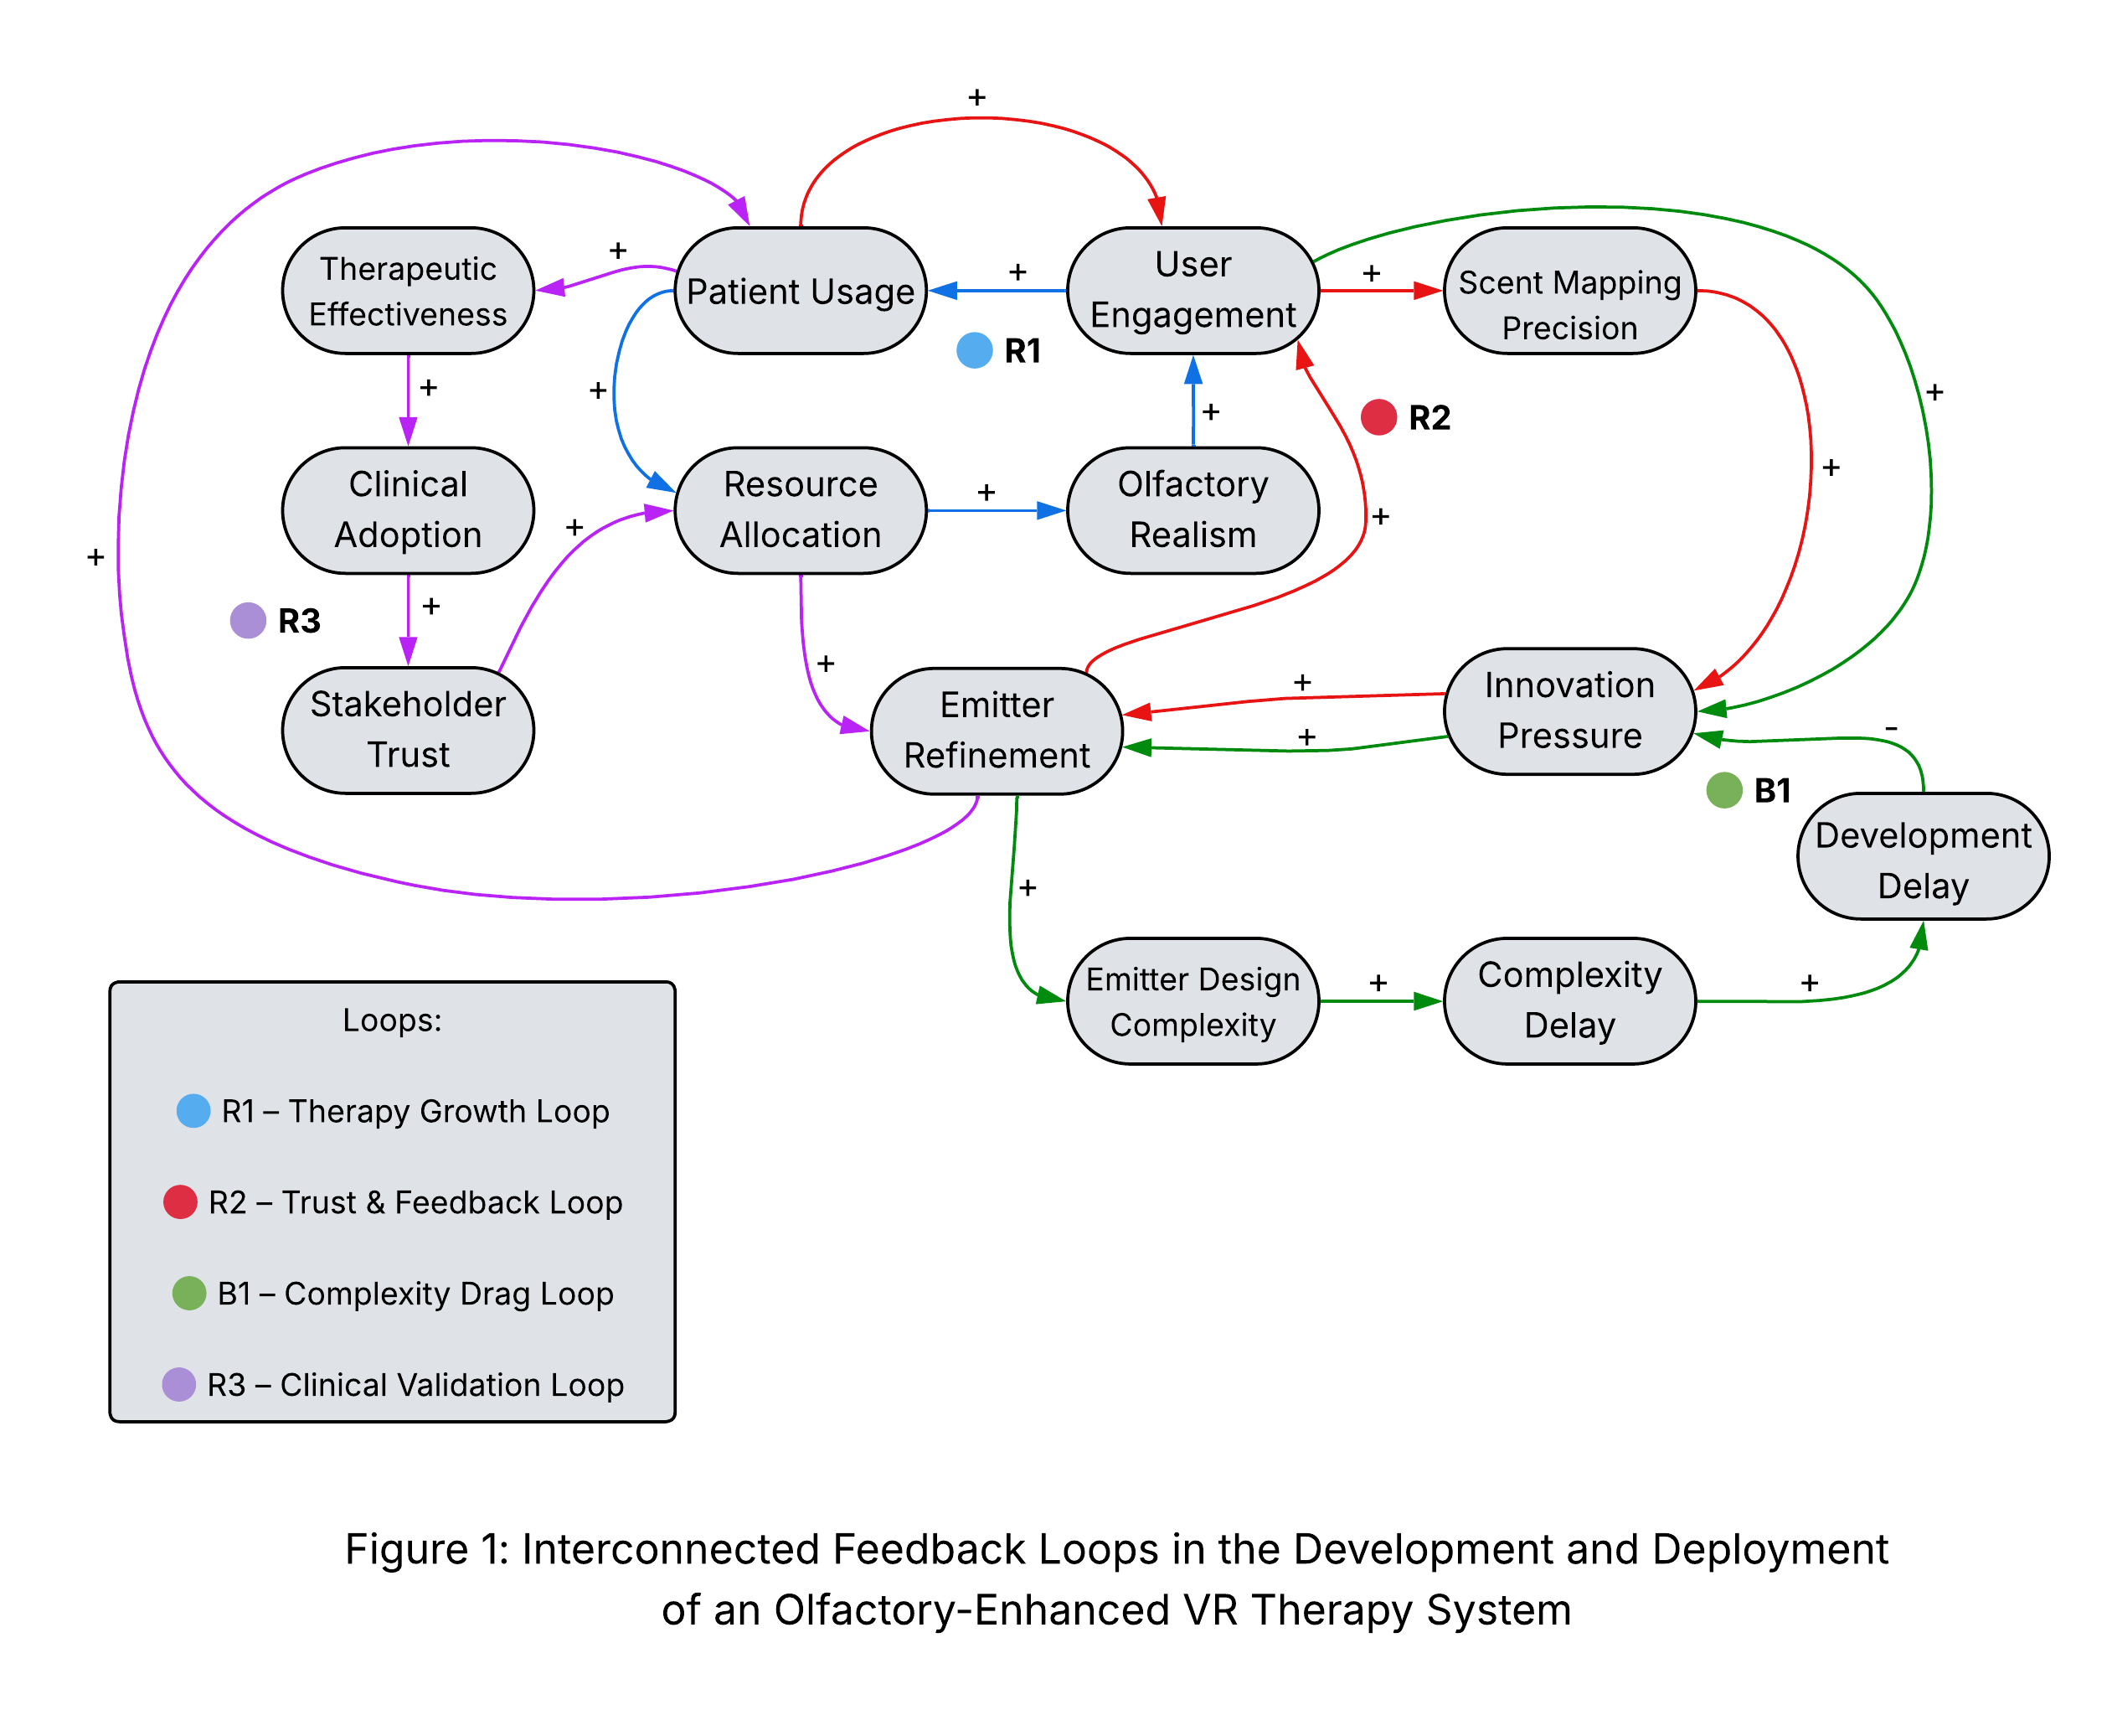
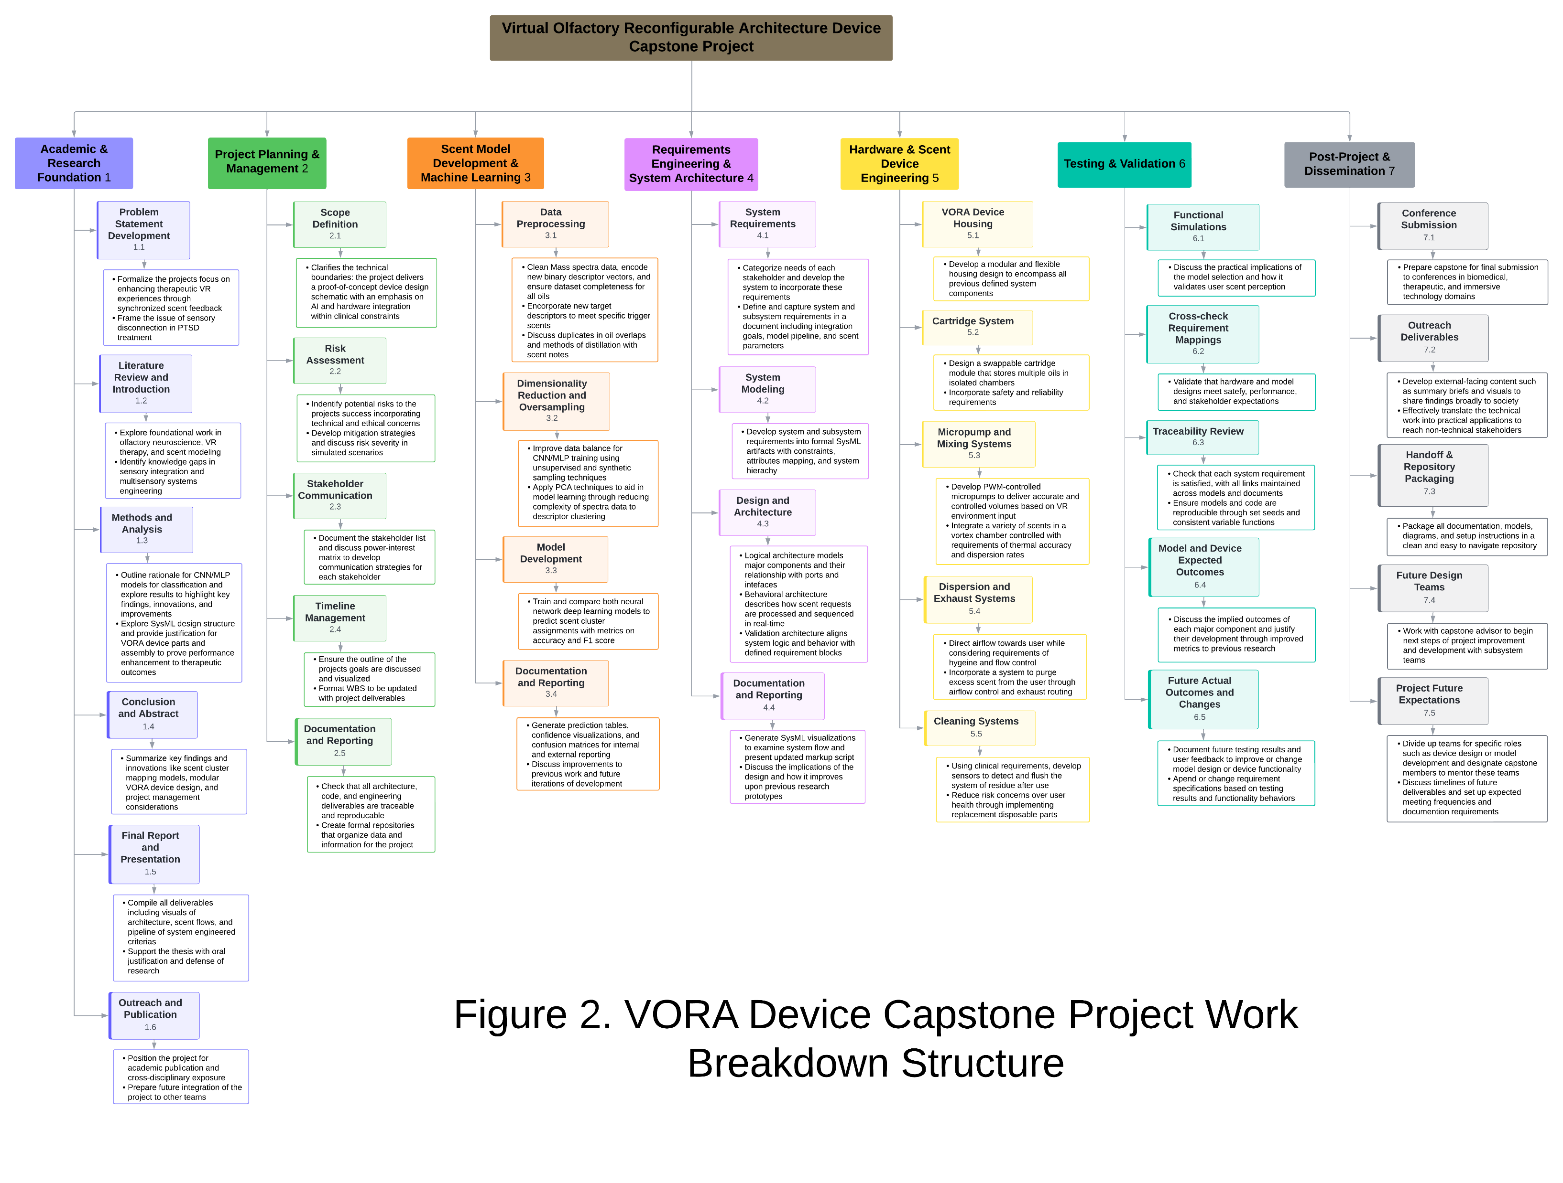
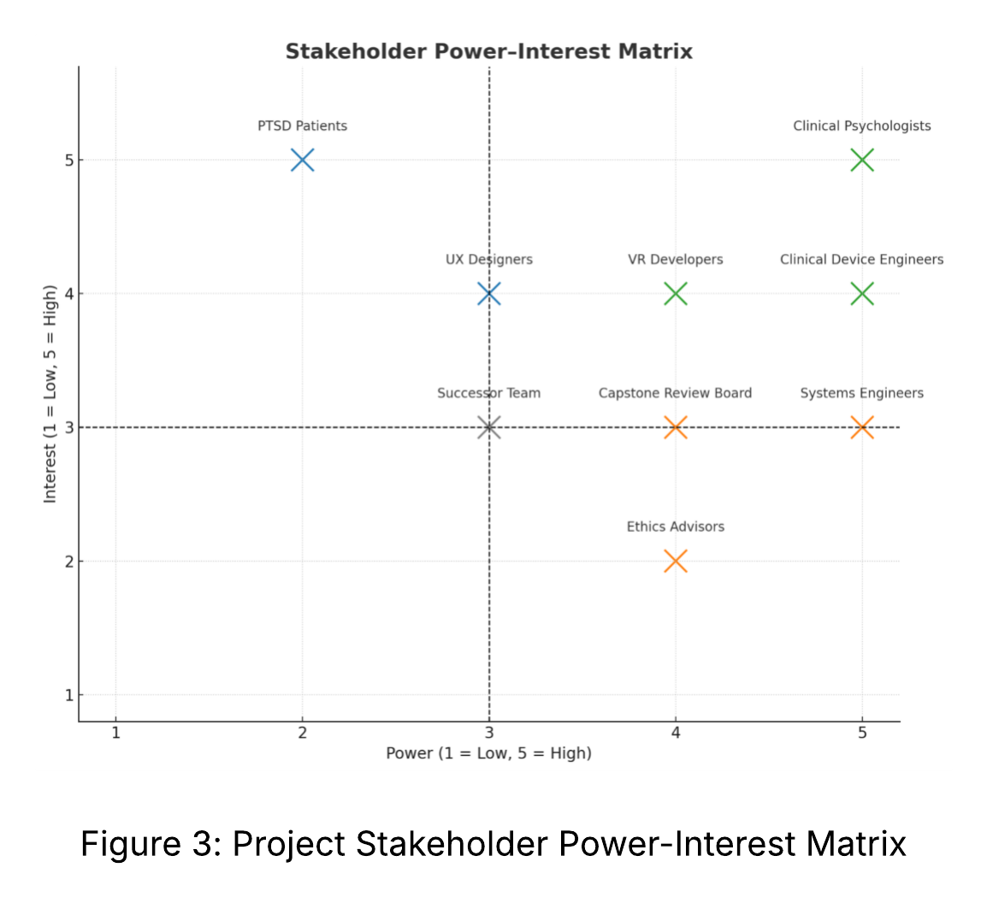


ELM 5313 – Systems Thinking
Applying Systems Thinking to Olfactory-Enhanced Virtual Reality Therapy for PTSD
A Causal Loop Analysis
Dawson McClary and Candice Reyes
Project Background
Analysis
Results/Conclusion
This poster applies systems thinking to model the complex interactions shaping the design, adoption, and refinement of a VR therapy system enhanced with olfactory feedback. This system is designed to support PTSD treatment by simulating immersive scent environments. Using causal loop diagrams, the analysis explores reinforcing and balancing feedback loops across patient engagement, technical development, and clinical validation.
This systems thinking analysis revealed the dynamics driving both the success and challenges of the olfactory-enhanced VR therapy device. By modeling causal feedback loops, we identified reinforcing and balancing structures that influence user experience, clinical adoption, and technical innovation.
Key System Behaviors
R1 - Therapy Growth: Patient usage and engagement increase system investment and refinement, reinforcing a positive growth cycle.
R2 - Trust & Feedback: User engagement fuels technical feedback, improving scent precision and overall user satisfaction.
R3 - Clinical Validation: Effective therapeutic outcomes boost adoption, stakeholder trust, and reinvestment into the project
B1 - Complexity Drag: Over-innovation increases complexity, which can slow down development if not managed and discussed.
Impact of Project Planning
Work Breakdown Structure (WBS): Loop analysis informed a modular task structure, especially in technical areas like emitter refinement and mapping. We aligned iteration-friendly subsystems like UX testing and scent classification mapping with fast-moving loops like R1 and R2, and structured long-term milestones around growth loops like R3.
Stakeholder alignment: Causal loop modeling clarified how stakeholders aligned across power-interest categories.
High-interest users: Act as feedback accelerators for the R2 loop
High-power stakeholders: Tied to trust nodes like clinical adoption in the R3 loop.
Overview of Objectives
The project focuses on two main objectives: developing a scent emitter device and modeling a classification system to guide scent placement. Causal loop analysis is used to identify opportunities for system growth, refinement, and potential setbacks across technical, clinical, and user-facing domains
This analysis aims to:
Apply causal loop diagrams to model system behavior and outcomes
Identify reinforcing and balancing feedback dynamics in different systems
Connect patient usage, user engagement, and resource allocation to different loops
Support future design decisions and clinical considerations
Features of the Analysis
R1 - Therapy Growth Loop
The loop takes into account patient usage with system investment properties, pairing that more investment in a better product drives further usage
R2 - Trust & Feedback Loop
The loop shows the impact of meaningful feedback on the improvement of scent precision and device refinement. It shows that further innovation from device refinement increases engagement.
R3 - Clinical Validation Loop
The loop validates that usage improves therapeutic outcomes which then increase clinical adoption and stakeholder trust. All key principle aspects of the system design and development.
B1 - Complexity Drag Loop
The loop expresses that innovation leads to more complex designs, but that more complexity brings developmental delays that can slow the system growth if it remains unmanaged.
Key takeaways
Systems thinking revealed the deeper feedback structure shaping design, usage, and clinical adoption.
Growth depends on managing complexity, which means innovation must stay scalable.
Clinical validation and user engagement are the strongest levers for sustainable impact.
The model guides future decisions in refinement, stakeholder alignment, and development pacing.
References
Debnath T, Nakamoto T (2020) Predicting human odor perception represented by continuous values from mass spectra of essential oils resembling chemical mixtures. PLoS ONE 15(6): e0234688. https://doi.org/10.1371/journal.pone.0234688 .
Cortese BM, Leslie K, Uhde TW. Differential odor sensitivity in PTSD: Implications for treatment and future research. J Affect Disord. 2015 Jul 1;179:23-30. doi: 10.1016/j.jad.2015.03.026. Epub 2015 Mar 31. PMID: 25845746; PMCID: PMC4437877.
Meadows, Donella H. (2008). Thinking in Systems.
O'Connor, J., & McDermott, I. (1997). The art of systems thinking: Essential skills for creativity and problem solving. Thorsons.
Sterman, J. D. (2000). Business dynamics: Systems thinking and modeling for a complex world. Irwin/McGraw-Hill.
Links
QR code links to:
Digital Poster Board
Capstone Thesis Report
Presentation Slides

